Slide 1
Smart Greenhouse Technology: Revolutionizing Remote Accessibility

Slide 2
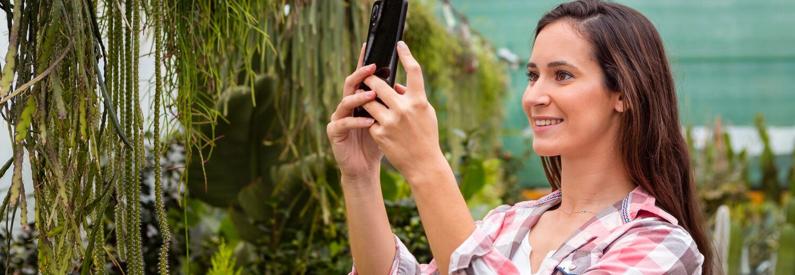
is revolutionizing remote accessibility in agriculture, allowing for precise control and monitoring of growing conditions from anywhere. Explore the advantages of this innovative approach.

Slide 3
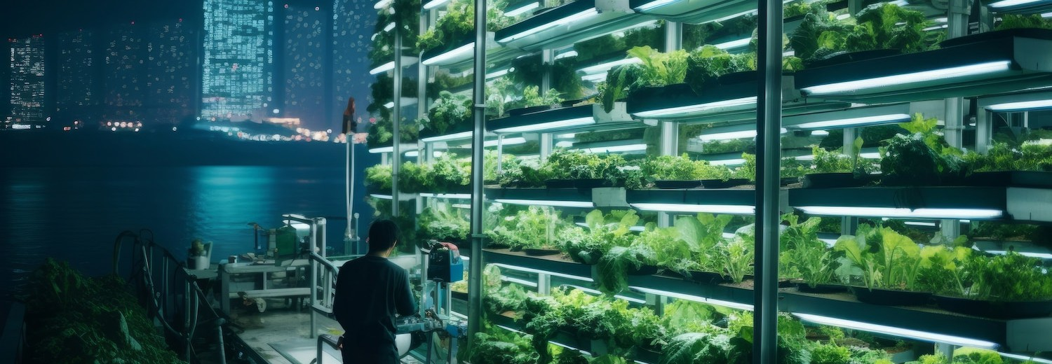
Smart greenhouse technology enables precise control over temperature, humidity, irrigation, and lighting to create the optimal growing conditions for plants. This level of automation and precision leads to improved yields and reduced resource consumption.

Slide 4
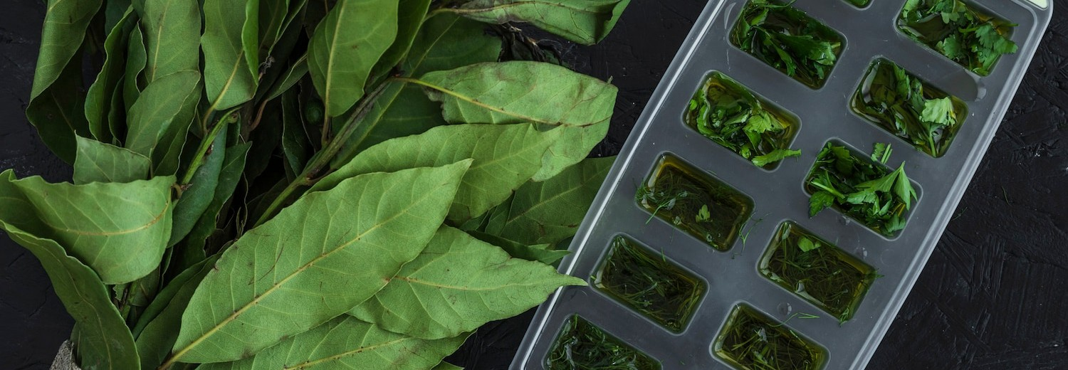
, growers can monitor and adjust growing
With
conditions remotely using mobile devices or web-based platforms. This allows for real-time decision-making and quick response to changes, enhancing productivity and efﬁciency.

Slide 5

Smart greenhouse systems collect extensive data on environmental conditions, plant growth, and resource usage. This data can be analyzed to identify optimization opportunities, predict issues, and make informed decisions to improve overall greenhouse performance.

Slide 6

Increased Sustainability
By leveraging precise control, automation, and data-driven insights, smart greenhouse technology promotes sustainable practices such as reduced water and energy consumption, minimized waste, and lower carbon footprint.

Slide 7
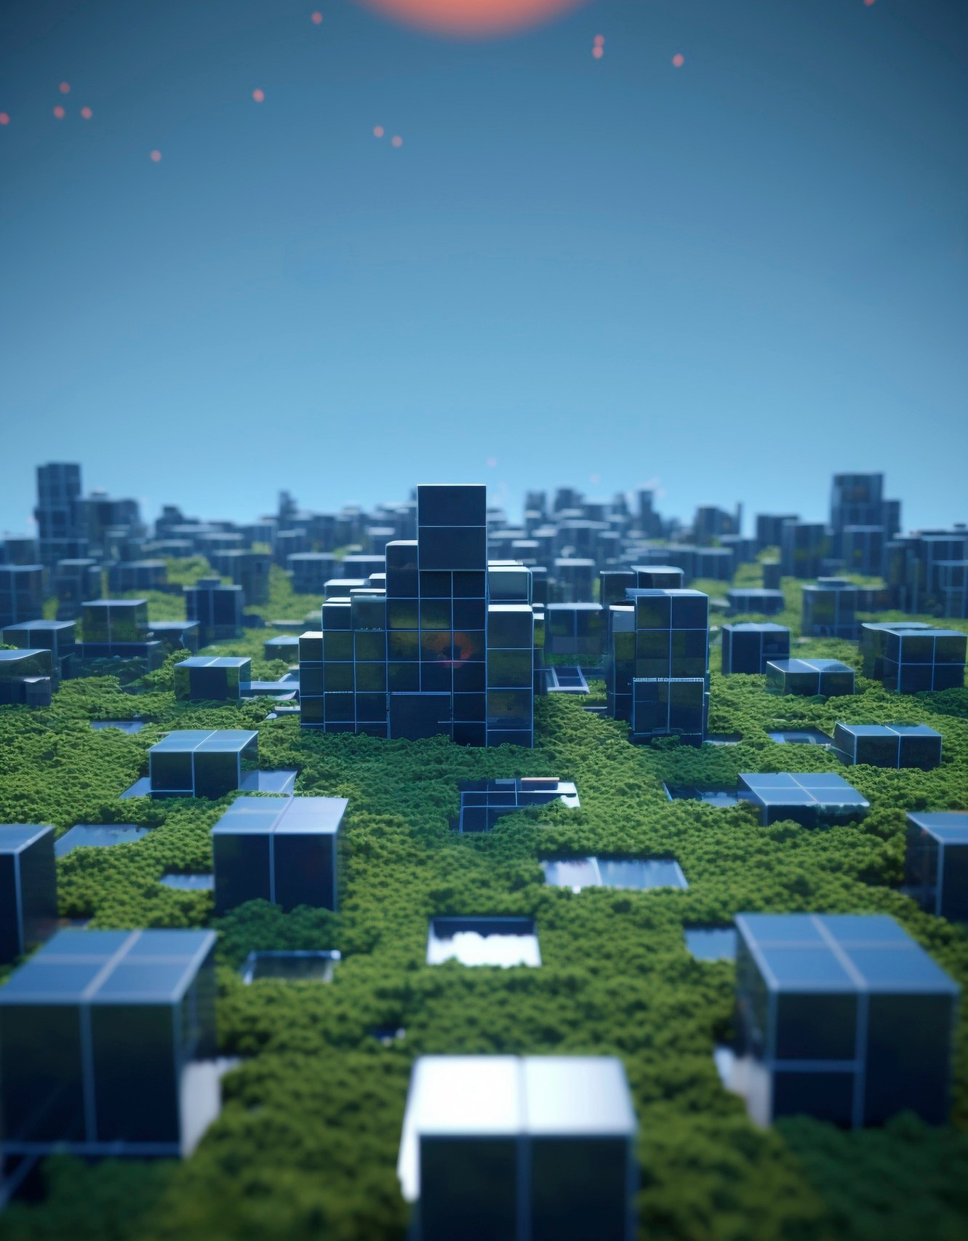
Revolutionizing the Future of Greenhouse Farming
Smart greenhouse technology is transforming the way we approach remote accessibility and control in agricultural settings. With its enhanced capabilities, data-driven insights, and sustainable practices, this innovative approach is paving the way for a more efﬁcient and responsive future in greenhouse farming.

Slide 8
Thank You!

